Slide 1
Stephanie Gil

Slide 2
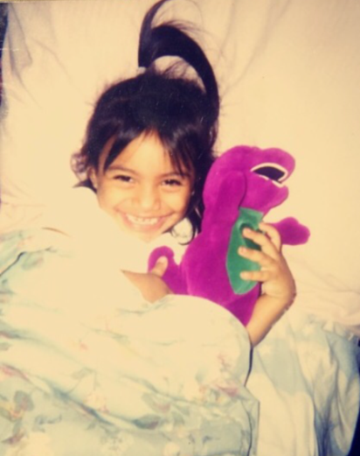
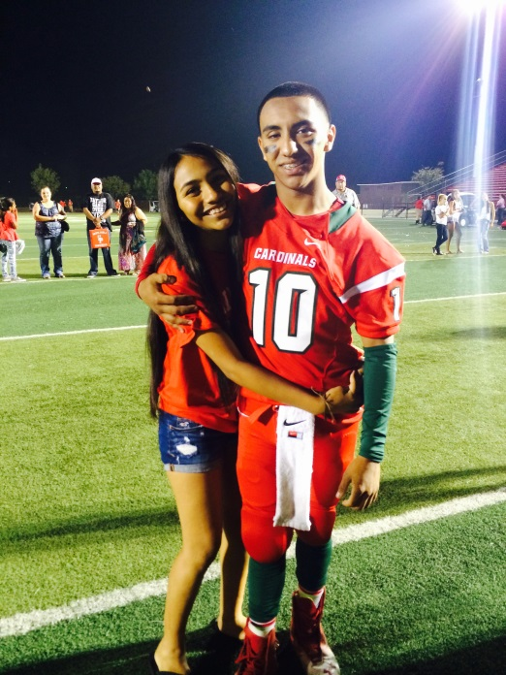
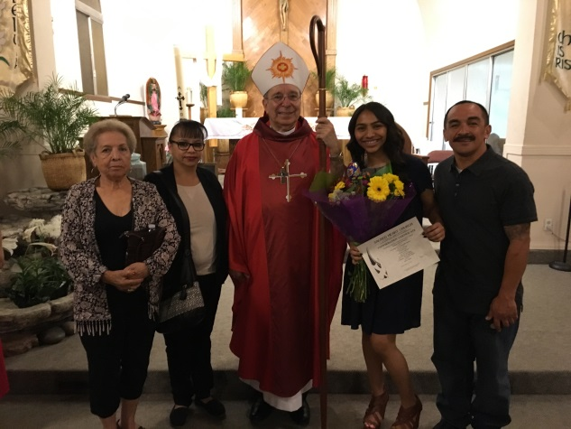
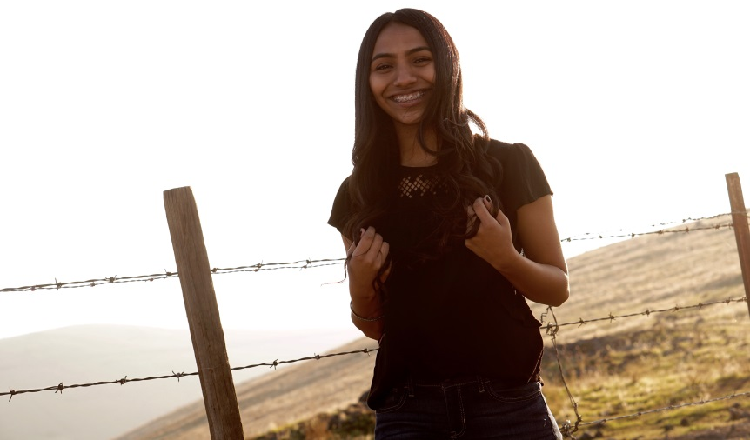
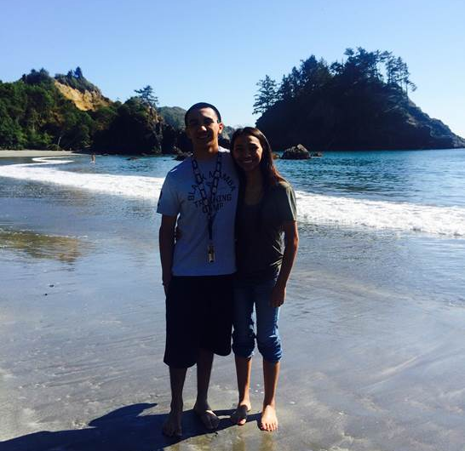
About Me
Family Background
I’m the youngest of 3
I’m 17 years old
Two older brothers
Interest/Special Skills
Cheerleading
Personal Challenges
Frustration
Sensitive

Slide 3
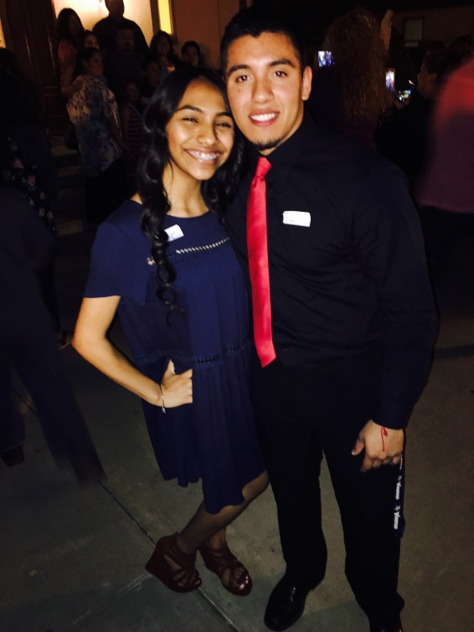
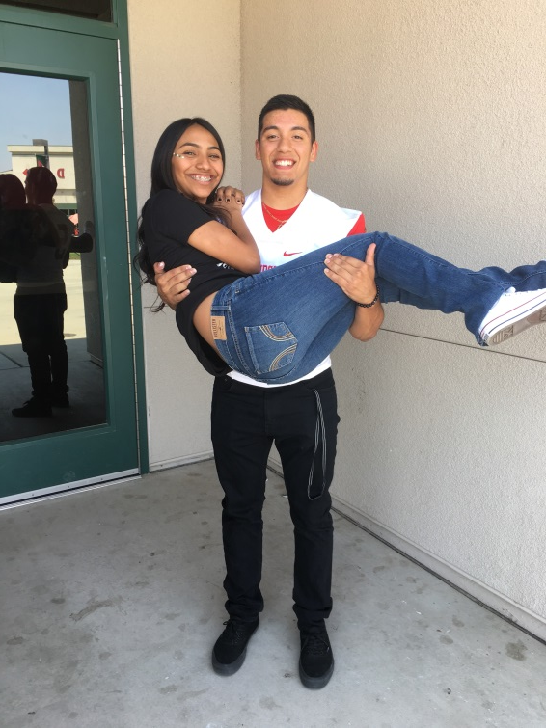
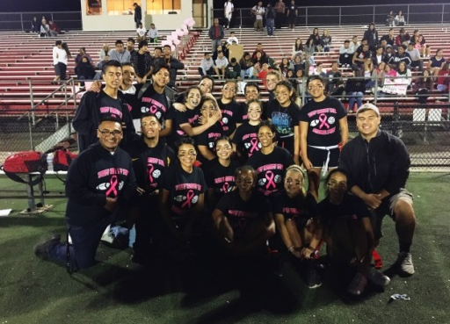
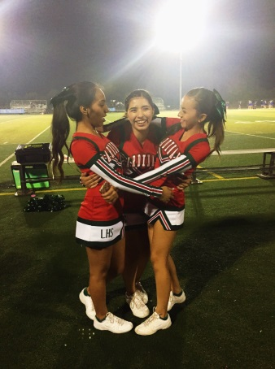
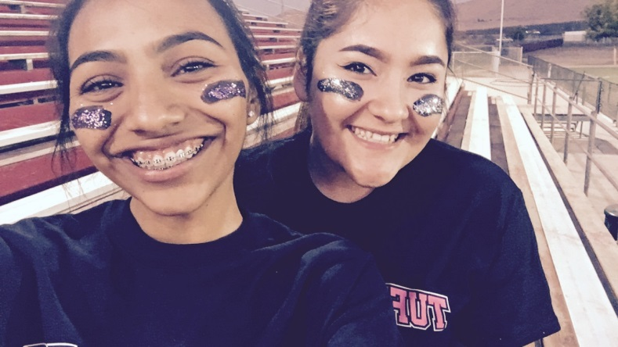
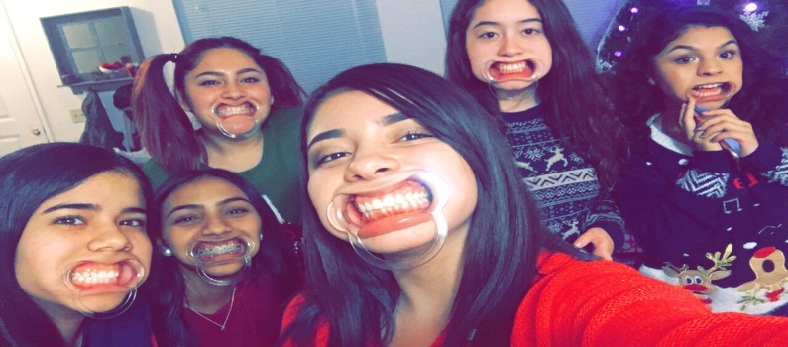
High School Experience
Clubs and Activities
ASB, Cheer, and Excursion Club
Challenges
My junior year was the hardest emotionally
PBS System
PBS system taught me how to take advantage of my learning
How High School Prepared Me
High school taught me how to be responsible

Slide 4
Job Shadow
About my Experience
Licensed Vocational Nurse (Elizabeth Martinez)
Becoming a nurse is one of my backup plans
I didn’t like it
Job was boring and grossed me out
Memorable moment was meeting all the nice nurses
I don’t see myself working in this type of field or environment

Slide 5
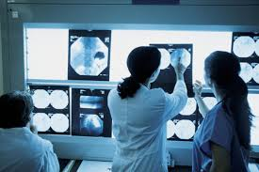
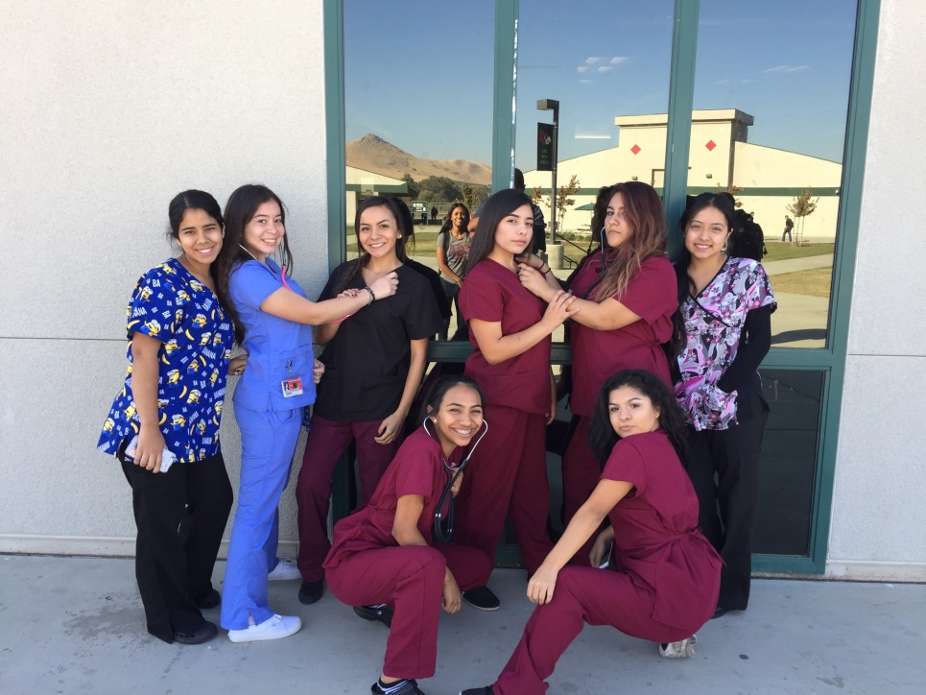
Pathway
Medical Services, because my dream job is part of this field
I will have to attend medical school to become a radiologist
I learned that I need to stay focused

Slide 6
Post High School Plans
I will attend Fresno State
I was still accepted to CSU Sacramento and CSU Chico
My financial support from my family is not the best
Short term goal is to pass my first year of college
Long term goal is to be successful and have a beautiful life

Slide 7
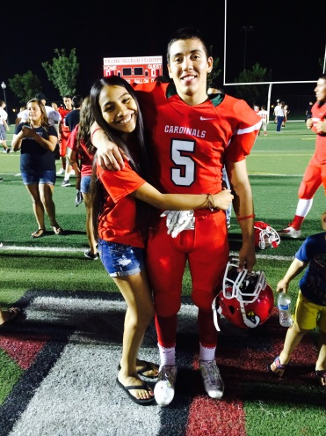
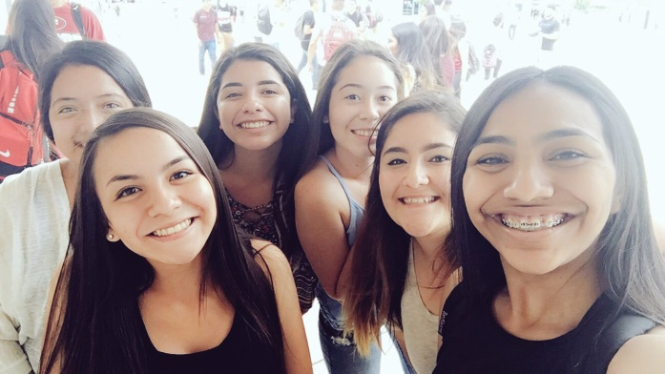
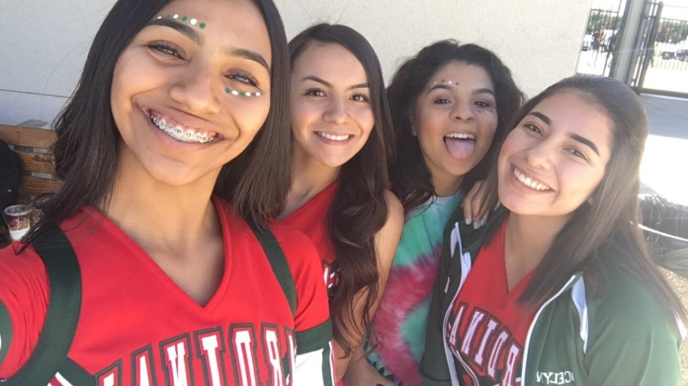
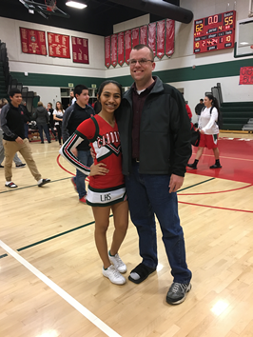
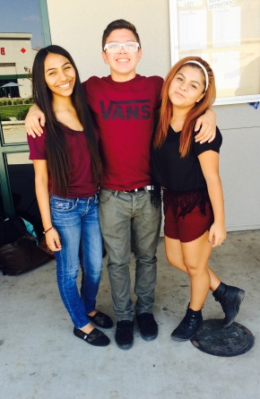
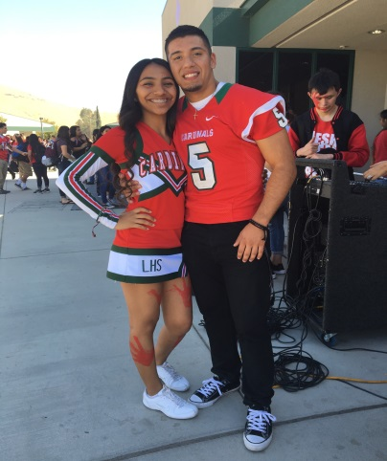
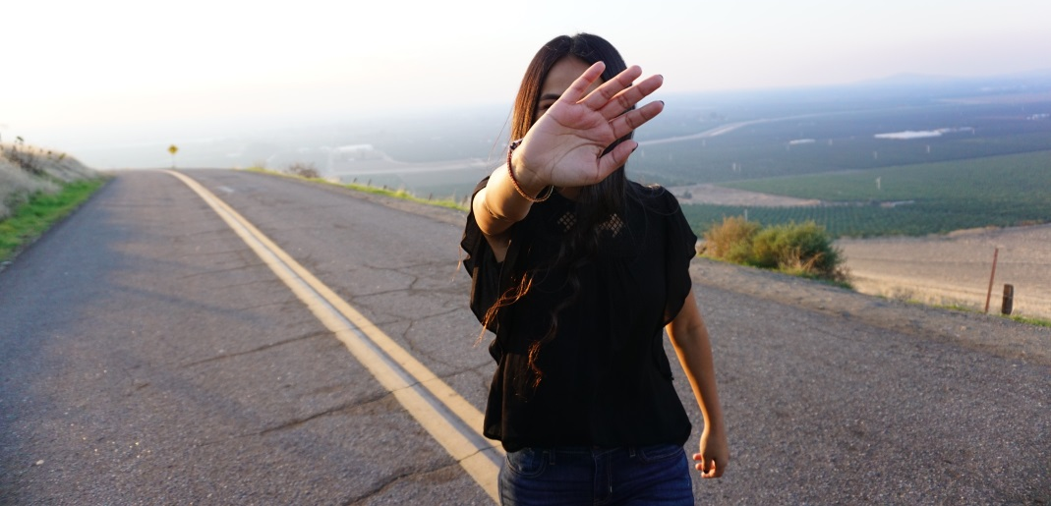
Leaving LHS
It’s been the best and worst four years of my life
This school made me strong and independent
Mr. Traeger and Mr. Gutierrez were the best teachers
PBS taught me to be responsible and hardworking

Slide 8
Thank you! Any questions?

